Slide 1

YEAR 7 DANCE

Slide 2
Lesson Objective
DEMONSTRATE AN UNDERSTANDING OF HOW THE OLYMPICS CAN BE USED AS A STIMULUS FOR A DANCE ROUTINE

Slide 3
Success Criteria
Level | Dance Strand
 | 1 Creating | 2 Performing | 3 Reflecting
E Entry | I can remember a range of actions I can create phrases based on a stimulus or music | I can participate in a short group performance I show some consideration of spatial awareness in performance | I can recognise when my own work and the work of others’, could be improved
1 G | I can perform simple dance phrase demonstrating choreographic skills | I can use appropriate characterisation in a performance | I can talk about why I made certain decisions in my choreography I can show a basic understanding of how a stimuli can be conveyed
2 F | I can create a choreography using unison and cannon I can learn teacher led sequences and then use these to develop my own levels I can create a choreography using a range of stimuli I can take on feedback to improve my choreography such as using levels and/or contract work I can sustain a focus within a performance | I can learn a routine and take part in simple performances | I can give suggestions on how work could be improved I can talk about my work using some dance terminology I can identify strengths and weaknesses in my own and others work
3 E | I can select and apply movement to match the given dance style I can work confidently in a group using a range of choreographic devices to explore different dance styles and ideas I can create and rehearse performance that make use of the range of techniques and dynamics to express my ideas I can give and accept suggestions to/from peers and teachers during the rehearsal process I can learn and create dances in a variety of styles | I experiment with different actions to create a performance I can create routines that are appropriate to the given style or stimuli I can experiment with different styles/actions and dynamics when developing a routine I improve and refine my performance through the rehearsal process I can choreograph a short performance for an audience I can perform a variety of different dance styles | I can reflect on and evaluate my own and other pupils’ work, suggesting improvements I can use key words when talking about dances that I have seen or participated in I can discuss the ways that ideas are communicated

Slide 4

STARTER ACTIVITY
WHAT IS FREEZE FRAME?
RECAP THE FREEZE FRAMES THAT YOU CHOREOGRAPHED LAST LESSON .

Slide 5
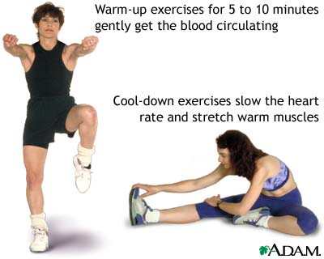
TASK ONE
FOLLOW THE CIRCUIT WARM UP IN GROUPS OF 5/6

Slide 6
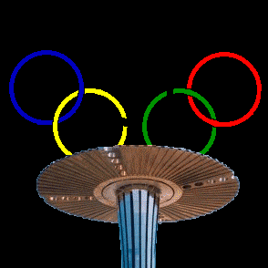
TASK TWO
RECAP THE OPENING ROUTINE TO THE OLYMPIC GAMES.
LEARN THE NEXT SMALL SECTION OF THE ROUTINE

Slide 7
TASK THREE
IN YOUR GROUPS CHOOSE A SPORT AND CREATE 8 MOVEMNTS THAT ARE ASSOCIATED WITH THE SPORT.
CHOOSE FROM THE FOLLOWING:
BASKETBALL.
TRAMPOLINING.
GYMNASTICS.
FOOTBALL

Slide 8
TASK FOUR
REHEARSE THE OPENING OF THE OLYMPIC GAMES.
REHEARSE YOUR FREEZE FRAMES.
REHEARSE YOUR MOVEMENT PHRASE BASED ON YOUR CHOSEN SPORT.
PERFORM YOUR OLYMPIC ROUTINES TO THE REST OF THE CLASS.
AUDIENCE ARE THE JUDIGES-WHAT GRADE DO YOU FEEL THEY HAVE ACHIEVED AND WHY.

Slide 9
PLENARY
WHAT LEVEL ARE YOU CURRENTLY ON? WHAT DO YOU NOW NEED TO DO TO IMPROVE YOUR GRADE?
3 4 5 6

